Slide 1

SPADE Introduction
Ma Diming
madiming@ic.sjtu.edu.cn

Slide 2
Outline
Motivation & Objectives
Analog Design Flow
SPADE Introduction
Assignments
Project Schedule
Q & A

Slide 3
Motivation & Objectives
Analog Designers Demand
  Design Automation
  Different Tools Integration
  Symbolic Instead of Numerical
GRASS Tool Right Here
  Symbolic, Optimal Solutions
  Sources
  Demand Oriented
Analog Circuits Class Lab
  Practical Use

Slide 4
Analog Design Flow
Schematic Descriptions
Circuit Descriptions
Netlist Descriptions
Numerical, HSpice, Spectrum
Simulation
Re-Design
Symbolic, GRASS
Waveforms, Curves, Avanwaves
Results & Analysis
Direct Optimal Results, W/L
No
No
Meet Requirements?
A, PM, Z-P, SNR, BW, SR, …
Yes, Design Done
Ideal: Requirements + Design Solution => Results

Slide 5
Analog Design Flow
GRASS is ClOSER to the Dream
  Symbolic => accurate
  Consider parameters variation
  Condense solutions to smaller ranges
  Alex authentications
Thus GRASS accompanied with analog designers produces SPADE

Slide 6
SPADE Introduction
SPADE is short for Simulation Program for Analog Design Education
thanks to his father, Pro. Shi.
Design Features
  Schematic Editor (Virtuoso, or SED)
  Simulator (HSPICE)
  2D/3D GUI for results representation
  Hierarchical design support
  Parameters variation consideration
  Basic analog design target consideration (PM, ro, A, etc.)
  Numerical simulation avoidance
  Matlab like function representation
  Specified model simulation
  … …

Slide 7
SPADE Introduction
Circuits
SPADE Flow
Netlist
DC Sim
Model Extraction
2D/3D Representations
H(S)
Graph Reduction
GRASS Role

Slide 8
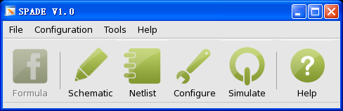
SPADE Introduction
A HSpice Like Interface
SPADE
Menu
Formula
Schematic Editor
Cadence ICFB
Netlist
Configure
Simulate
Help & About
Points
Flow is like: Formula / ICFB->Netlist->Configure->Simulate
2D/3D, Parallel, etc. options decided by user to show the results

Slide 9
SPADE Introduction
SPADE
Menu
Formula
Schematic Editor
Cadence ICFB
Netlist
Configure
Simulate
Help & About
List
X-Y Position
X
2D/3D
Default Formula
Current
Properties (range, points …)
Conductance
Tab1
Tab2
Category
…
User Defined
3D / 2D View
User Group
…
New Add

Slide 10
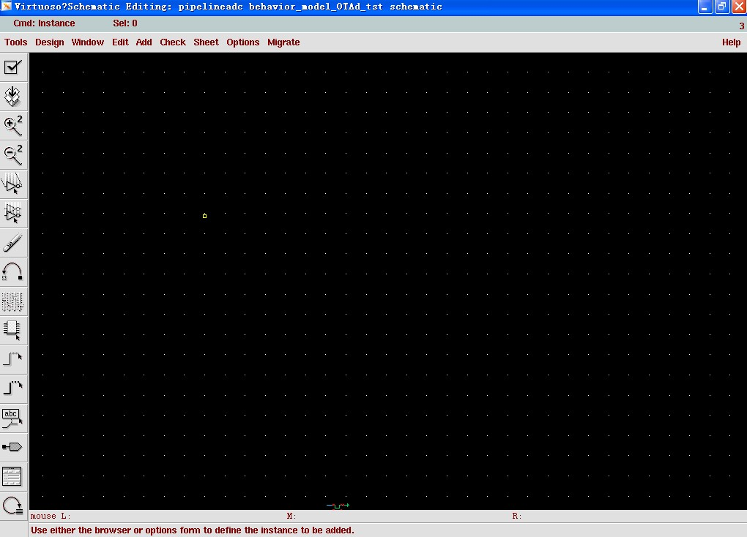
SPADE Introduction
SPADE
Menu
Formula
Schematic Editor
Cadence ICFB
Netlist
Configure
Simulate
Help & About
Launching Cadence ICFB / Virtuoso
Or
Schematic Editor

Slide 11
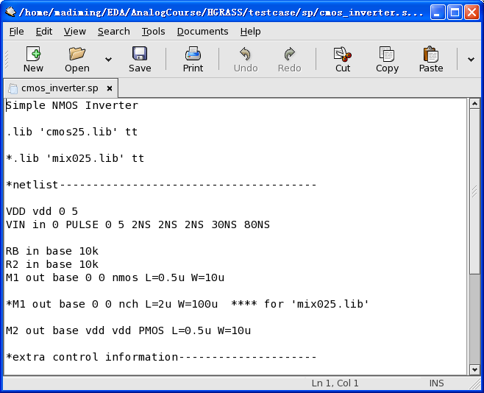
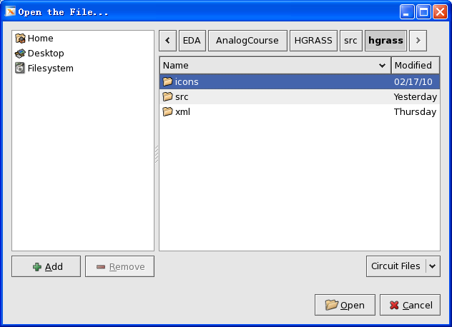
SPADE Introduction
SPADE
Menu
Formula
Schematic Editor
Cadence ICFB
Netlist
Configure
Simulate
Help & About
Multi-tab Editor
or
GEditor, Vim, Emacs, etc.
(For Editing, Saving, etc.)

Slide 12
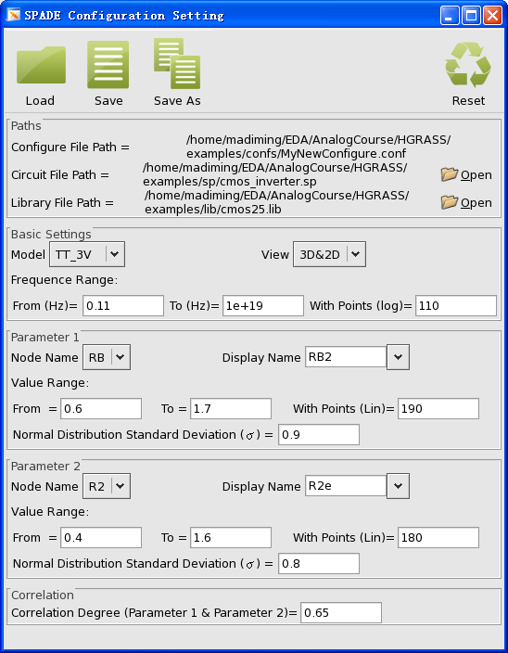
SPADE Introduction
SPADE
Menu
Formula
Schematic Editor
Cadence ICFB
Netlist
Configure
Simulate
Help & About
Lib, model, path setting
2D/3D setting
Frequency range setting
Focused device range setting
PDF Setting
Other Settings
Point is embed all the properties of result curve as phase margin db, frequence db, etc. inside the tool

Slide 13
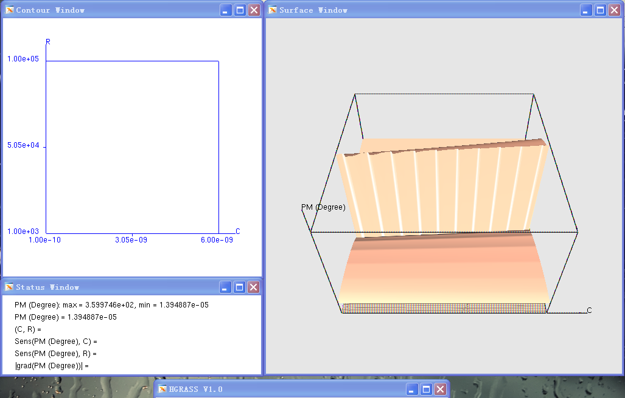
SPADE Introduction
SPADE
Menu
Formula
Schematic Editor
Cadence ICFB
Netlist
Configure
Simulate
Help & About
HSpice DC run
TKY’s script for parameters extraction
GRASS run
Results representation in 2D/3D view

Slide 14
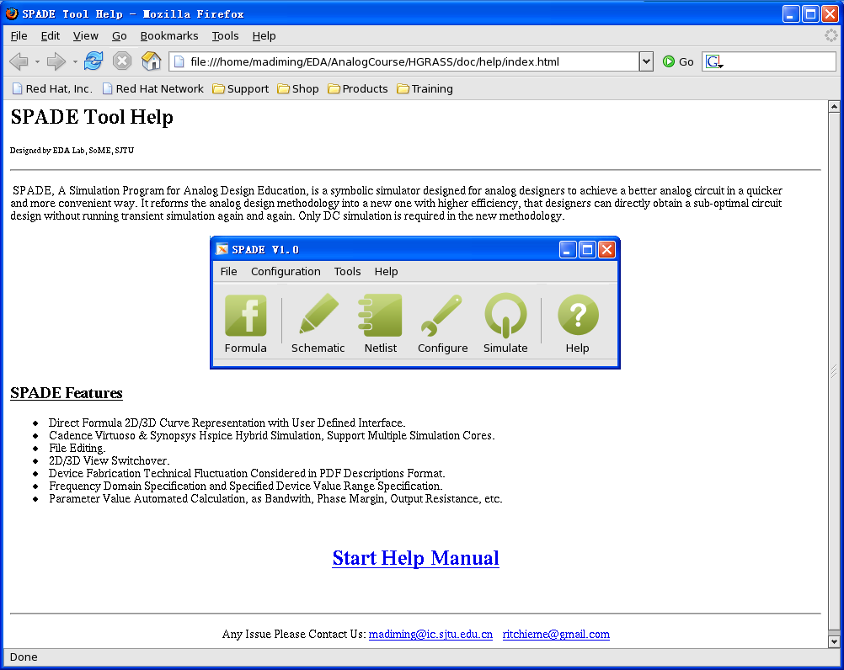
SPADE Introduction
SPADE
Menu
Formula
Schematic Editor
Cadence ICFB
Netlist
Configure
Simulate
Help & About
Html / PDF Auto Generation
Better if man is added

Slide 15
Assignments
Schematic Editor
Model Related
Hierarchical Design Supported
Parameter Extraction
Gtk/Qt/OpenGL Integration
Formula
Design Targeted Oriented (Ro, P-Z, etc.)
……

Slide 16
Assignments
Li Xiaopeng: Scripts Related
  Hierarchical design
  Parameter extraction
  Parser
Xu Hui: Design Target Oriented
  Output impedance
  …
Zhang He: Qt & OpenGL Related
  3D GUI integration & transplant
Weng Binbin: Gtk Related
  Formala
Huang Weijian: Supervise
  Supervise, advise, evaluate, feedback
Ma Diming: Tool Related
  All things left

Slide 17
Project Schedule
Milestone 1: 15th March (Res: Ma Diming)
  Parser (Res: Li Xiaopeng)
Milestone 2: 16th April (Res: Ma Diming)
  Output Impedence (Res: Xu Hui)
  Hierarchical Support (Res: Li Xiaopeng)
  3D Integration (Res: Zhang He)
  Formula (Res: Weng Binbin)
Milestone 3: End of the semester (Res: Ma Diming)
  Model Related (Assignments Not Ready Yet)

Slide 18
Q & A
Thank You

